Slide 1
Harold Pulcher
Senior Consultant and Microsoft MVP

Slide 2
Upcoming Virtual Training Courses
Use code Tech-Fest-2020 to take $500 off the list price for any of the courses below
PSM September 29-30
The Professional Scrum Master (PSM) certification course is a 2-day certification course that covers the principles and empirical process theory underpinning the Scrum framework, and the role of the Scrum Master in it.
PSM II October 7-8
The Professional Scrum Master II™ (PSM II) certification course is a 2-day advanced Scrum Master class designed to support Scrum Masters in their professional development. The PSM II class is intended for Scrum Masters with at least one year of experience who are looking to grow their knowledge and abilities as a Scrum Master.
PSPO October 20-21
The Professional Scrum Product Owner (PSPO) certification course is a 2-day course where participants learn how to leverage Scrum to maximize the value of products and services.
For more information or to sign-up, visit:
www.improving.com/training

Slide 3

We’re Hiring
Senior Front-End .Net Developer
– React, Node, Javascript
Senior Java Developer
Senior Full Stack Developer
Junior Full Stack Developer
– Microsoft Stack, Angular 2+
Senior .Net Developer
– .Net Core, strong SQL, backend, and testing experience
Senior .Net Developer
– .Net Full Stack with React or Angular
Send resumes to careers@improving.com
*reference your closest office (we have 14 now)

Slide 4
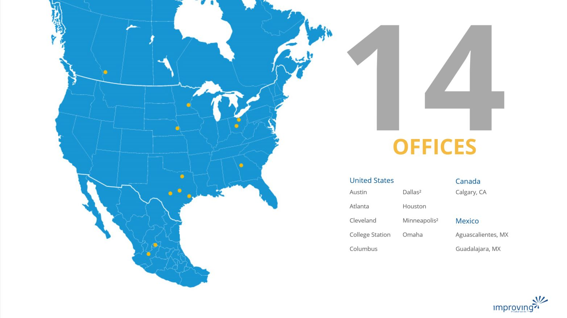
Share details about an upcoming event, conference, user group, booth raffel ect here.

Slide 5
Training class advertisement here​
For details around upcoming training courses available, please check with your local business development managers/office leadership
Fridays at 12pm CST
See past talks on our YouTube Page
https://bit.ly/2Rd0WC5

Slide 6

Harold Pulcher (MVP) @haroldpulcher pulcher@pulcher.biz
https://youtube.com/user/hpulcher https://twitch.tv/haroldpulcher
https://github.com/pulcher/blazor-playground/tree/master/talks/houston

Slide 7
Agenda:
What is Blazor?
Getting Started
New Features in Blazor WebAssembly
What’s Next
Fun Stuff!

Slide 8




https://...
JS

Slide 9
INTERACTIVE WEB UI FOR .NET
A BIGGER APP ON WEBASSEMBLY

Slide 10
Why you should be interested in this?
C# Language
Tooling / IDE
Consistent ecosystem
Stability

Slide 11



https://...
DOM
Client-side
(Blazor WebAssembly)

Slide 12
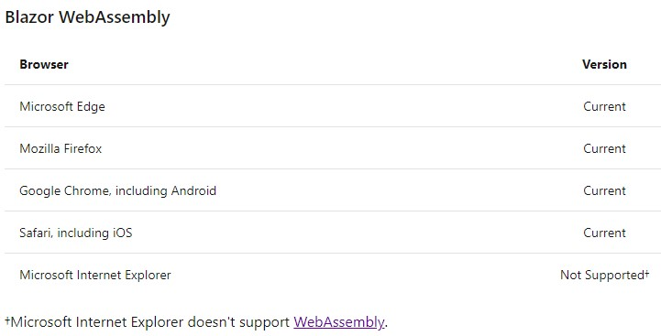

Slide 13


https://...
https://...
SignalR
DOM
DOM
Client-side
(Blazor WebAssembly)
Server-side
(Blazor Server)

Slide 14
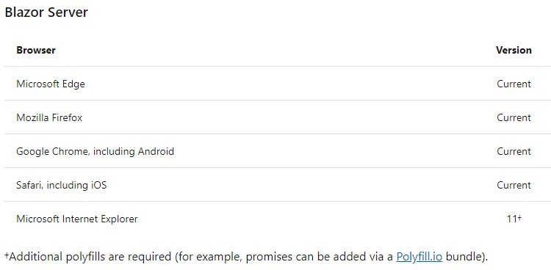

Slide 15
Client-side
(Blazor WebAssembly)
Server-side
(Blazor Server)
Shipped
Released in .NET Core 3.1
Shipped
Released in .NET Core 3.0
Great for:
- Offline support / PWA
- Zero latency UI
- Static-files hosting
Great for:
- Thin client
- Full runtime
- All code on server

Slide 16
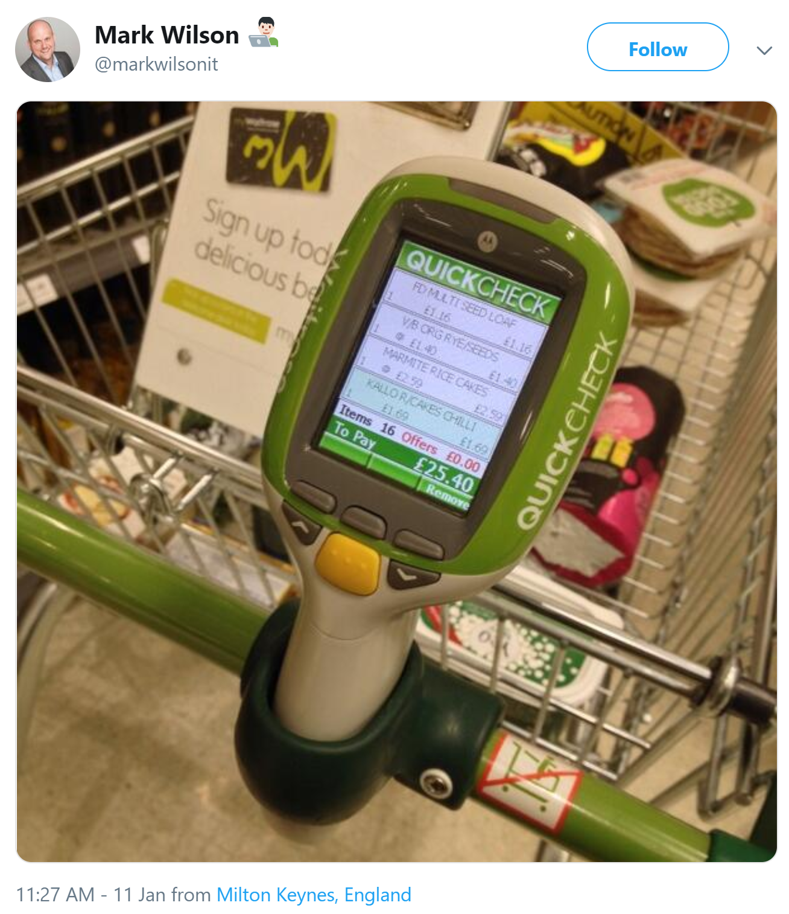

Slide 17
Get Started
Pick your tool of choice: Visual Studio 2019, Visual Studio Code, or Visual Studio for Mac
Install .NET Core 3.1 SDK: dot.net/get-core3
For Webassembly:
For Server:
dotnet new blazorwasm -o blazor-wasm1
cd blazor-wasm1
dotnet run
dotnet new blazorserver -o blazor-server1
cd blazor-server1
dotnet run

Slide 18
Let’s see this in action!

Slide 19
Authorization
Code sharing
JavaScript interop
Debugging
Internationalization
Progressive Web Apps

Slide 20
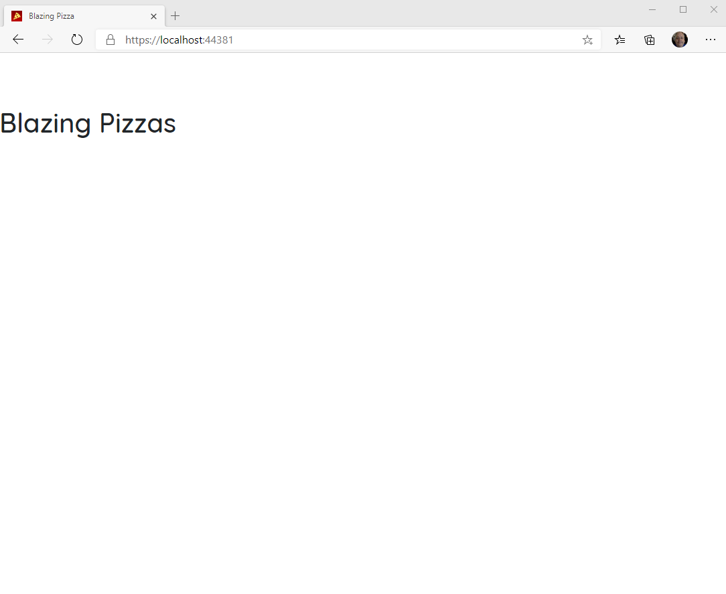
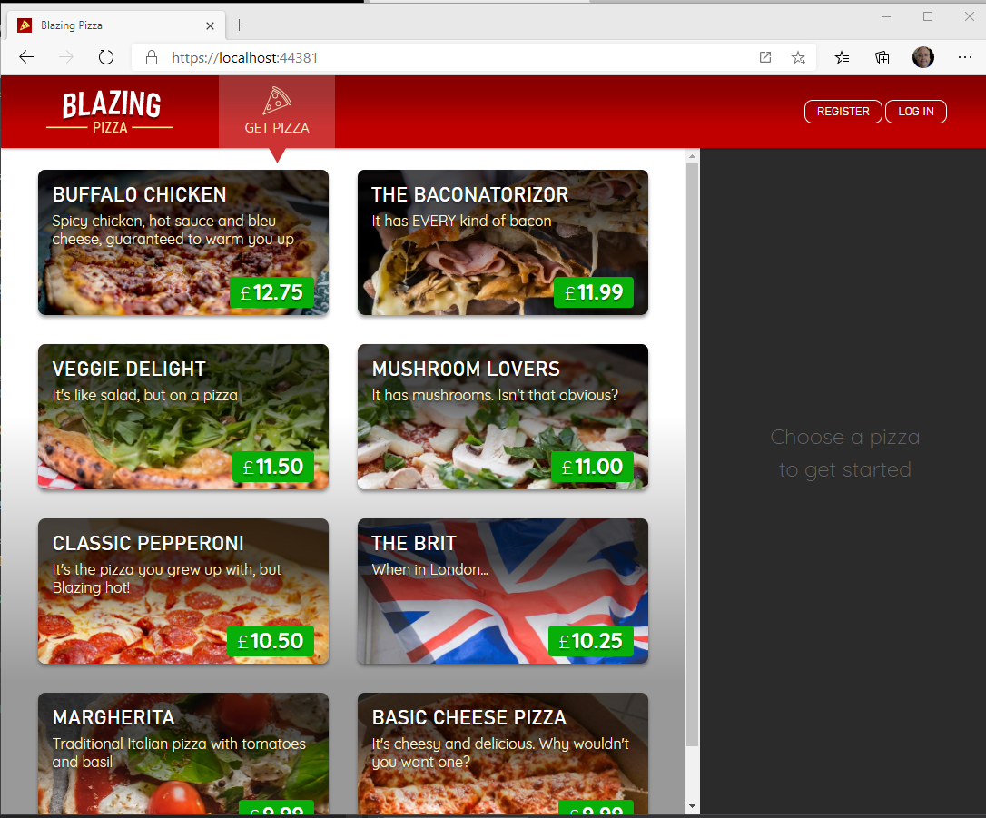

Blazor Workshop
Just Do It!!!!
https://github.com/dotnet-presentations/blazor-workshop

Slide 21
Client-side
(Blazor WebAssembly)
Server-side
(Blazor Server)
Shipped
Released in .NET Core 3.1
Shipped
Released in .NET Core 3.0
Blazor Hybrid
(Desktop app with web rendering)
Blazor + Native UI
(Mobile/desktop with native OS UI)
Uncommitted. Samples:
aka.ms/blazor-electron aka.ms/webwindow
Uncommitted. Samples: aka.ms/mobile-blazor-bindings

Slide 22
What’s next?
Blazor in .NET 5 (Build + Runtime)
Component API Enhancements:
Type constraints, Required Parameters…..
SVG
CSS Isolation
WebAssembly Specific
Multithreaded Runtime
Lazy-Loading

Slide 23
My Asks:
Head over to http://blazor.net and give it a go
Checkout https://aka.ms/blazor-carchecker
Do the workshop!
Send me some feedback: pulcher@pulcher.biz
Follow me on Twitch: @haroldpulcher

Slide 24
Links and stuff
Steve Sanderson Video (used the start of this) presentation: https://www.youtube.com/watch?v=Khn7sDUSEJM
Webassembly base information: https://webassembly.org/
Blazor Getting Started: https://docs.microsoft.com/en-us/aspnet/core/blazor/get-started?view=aspnetcore-3.1&tabs=visual-studio
Blazor Templates: https://www.nuget.org/packages/Microsoft.AspNetCore.Blazor.Templates/
Blazor Routing: https://docs.microsoft.com/en-us/aspnet/core/blazor/routing?view=aspnetcore-3.1
Blazor Workshop: https://github.com/dotnet-presentations/blazor-workshop
WebWindow: https://github.com/SteveSandersonMS/WebWindow
.Net Conf: Focus on Blazor: https://channel9.msdn.com/Events/dotnetConf/Focus-on-Blazor
Basteroids: https://aesalazar.github.io/AsteroidsWasm/
Blazor Pacman: https://pacmanblazor.azurewebsites.net/

Slide 26
WITH
FUTURE
FEATURES
INTERACTIVE WEB UI FOR .NET
A BIGGER APP ON WEBASSEMBLY

Slide 27
WITH
FUTURE
FEATURES
A BIGGER APP ON WEBASSEMBLY
BLAZOR EVERYWHERE
gRPC
Testing
PWA

Slide 28
WITH
FUTURE
FEATURES
A BIGGER APP ON WEBASSEMBLY
BLAZOR EVERYWHERE
gRPC
Testing
PWA

Slide 29

LEARN MORE & GET STARTED
blazor.net
Steven Sanderson
@StevenSanderson

Slide 30
Code sharing

Slide 31
JavaScript interop

Slide 32
Debugging

Slide 33
Internationalization

Slide 34
Progressive Web Apps

Slide 35
LEARN MORE & GET STARTED
blazor.net
CODE & SLIDES
aka.ms/sanderson-london-2020
== https://github.com/SteveSandersonMS/presentation-2020-01-NDCLondon
Steven Sanderson
@StevenSanderson

Slide 36

1
2
3
PIN
* * * *
CART
Item 1
£3.95
Item 2
£12.00
Total: £15.95
0000 0000 0000 0000

